Slide 1
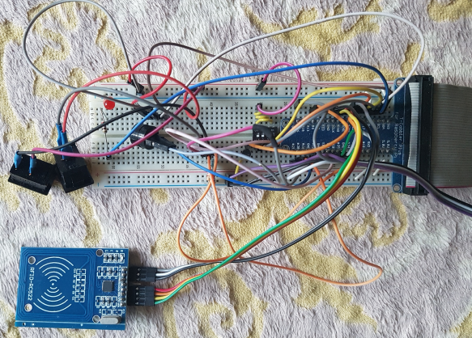
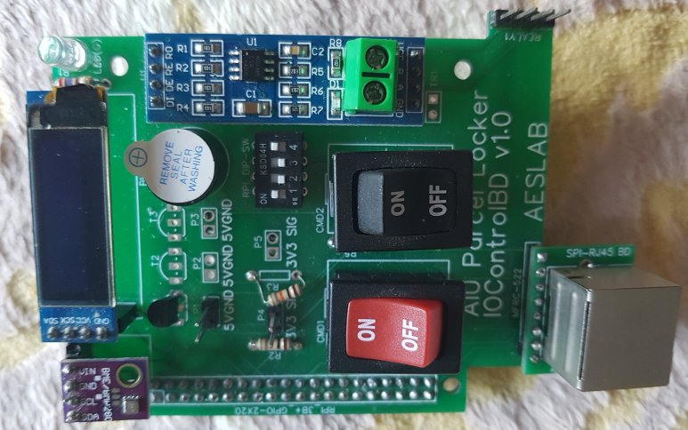
Introduction to MLS (Multi Layer Stackable) Hat Series
MLS Hat series developed by AESLAB are released at Dec. 2021.
Many makers use breadboard. But just create only, not long time use and
most displeasing jumper cables.
Raspberry Pi 2x20 GPIO
prototyping with
breadboard and devices
Make own PCB work is not complex things nowadays, But its not simple to
novices, makers and hobbyist, still many huddles remains.
PCB from prototype
test result
For example, find foot print and cross check between device and foot print,
modern CAD tools has very advanced and support 3D assemble views, but
finding exact device from online market need time consuming and efforts.
Nov. 2021
AESLAB
1

Slide 2
Situation considering :
Many MCU boards and module boards available now
but we need still jumper wires.
Uncountable resources are available in internet and videos
lead by open hardware and software trends.
Experts can make nice electronics boards simply with low cost.
If a maker wish to get nice PCB result for various need without
jumper cables and breadboard…
option 1. Out-sourcing … Nonsense.
option 2. Studying PCB works … Spend time.
Someone think like “I want to get nice PCB board like expert result,
But I don’t want to spend my time to make PCB.” excluding option 1
and option 2…….No ways.
And soldering also required detail skills.
HLS Hat series will be another solution for this simple hope.
MCU hardware GPIO worlds are consist by only 7 things.
GPIO Input, output
PWM
ADC
UART
I2C
SPI
Exactly can not support all kind need, But a little availabilities are
possible with pre-worked PCB for novices, makers and hobbyist.
HLS Hat series can help this!
Nov. 2021
AESLAB
2

Slide 3
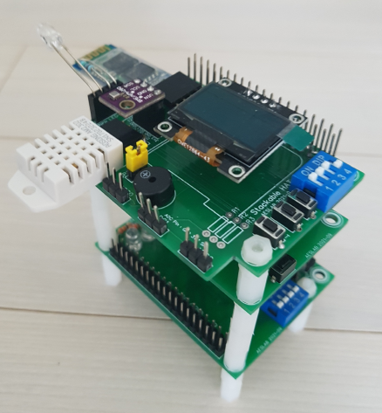
MLS Hat Configuration Example
Hat-0 + Pico Base A1 + Hat-1
Nov. 2021
AESLAB
3

Slide 4
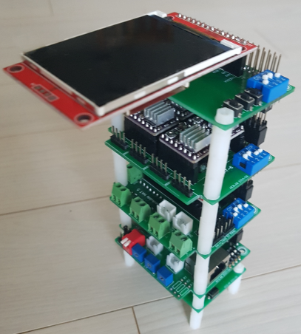
MLS Hat Configuration Example
Pico Base A1 + Hat-4 + Hat-5 + Hat-6 + Hat-3
Nov. 2021
AESLAB
4

Slide 5
MLS Hat series support :
Multi layer stacking availability
May 3~5 layers can achieve a little complex results.
Between the hats height gap is 32mm, plastic supports
(2/10mm, M3 screw) are included.
Each hat has specific purpose
with long time embedded system design experience
First release (Nov. 2021)
Raspberry Pi Pico Base A1
Hat-0 : Dual Raspberry Pi 3/4 2x20 GPIO Use
Hat-1 : Flowerpot (LED/Buzzer/OLED/ADC/DHT22/Bluetooth)
Hat-3 : Display (I2C/SPI)
Hat-4 : IO Combo (TR-Out/In/SPI-RJ45)
Hat-5 : Motor (x4 DC Motor, 6 Servo Motor)
Hat-6 : Motor (x4 NEMA17 Stepping Motor)
Under ready, 2nd release (Dec. 2021)
Raspberry Pi Pico Base A2 : Add ESP-01 WiFi, Bluetooth
Hat-2 : 10 Buzzers MIDI Player with SD Card module
Hat-7 : IMU, Various I2C/SPI Acceleration/Gyro/Magnet Module
Hat-8 : MCP Combo (GPIO Expander/ADC)
Hat-12 : 4 Gas Sensor support (include MCP3004)
Under development, 3rd release (Jan. 2022)
STM32F Bluepill/Blackpill Base A1
Hat-9 : Wire Communication Combo
Hat-10 : Wireless Communication Combo
Hat-11 : Opto-coupling 2xIN, 2xRelay Out
Up to total 24~30 MLS hats release plan till end of 2022.
Each hat has DIPSW(x4)
for enable and disable for each sub function
Thus user just DIPSW on/off for need
Each hat has 4 functions normally
Reasonable small form factor (41x65mm, 49x65mm)
No Soldering, Just insert your module, Just stacking MLS Hats
All tested MicroPython library and test code supports
Nov. 2021
AESLAB
5

Slide 6
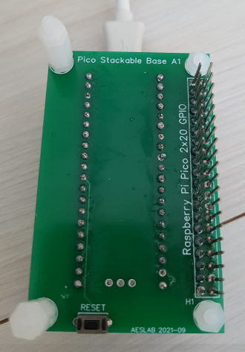
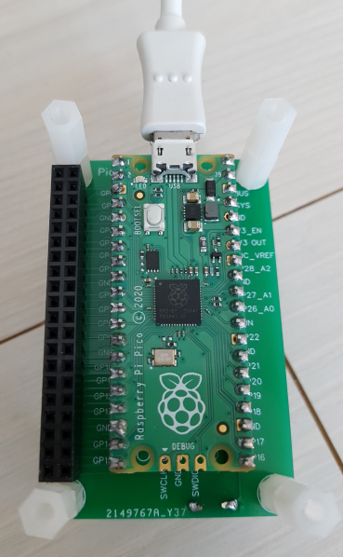
Pico Base A1 :
Pico Base A1 for Raspberry Pi Pico.
2x20 GPIO header for top side and bottom side.
A hardware RESET button, 41x65mm.
Product : MLS Pico Base A1 PCBA (PCB Assembled)
MLS Pico Base A1 Set (include Raspberry Pi Pico and
soldered two 1x20 Male header)
Pico Base A1 is for MLS Hat base for Pico MCU users.
MLS Hat interconnected 2x20 GPIO header.
Raspberry Pi Pico has Two 1x20 headers both side of board.
Pico board size is 20x50mm.
Pico board form factor is too small to practical functionality.
Left side : 2x20 GPIO header
Right side : IO Connector
Top side : Various device, for example Bluetooth or WiFi modules
Bottom side : Buttons and DIPSW
Top View Bottom View
Nov. 2021
AESLAB
6

Slide 7
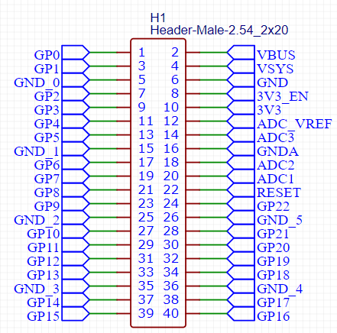
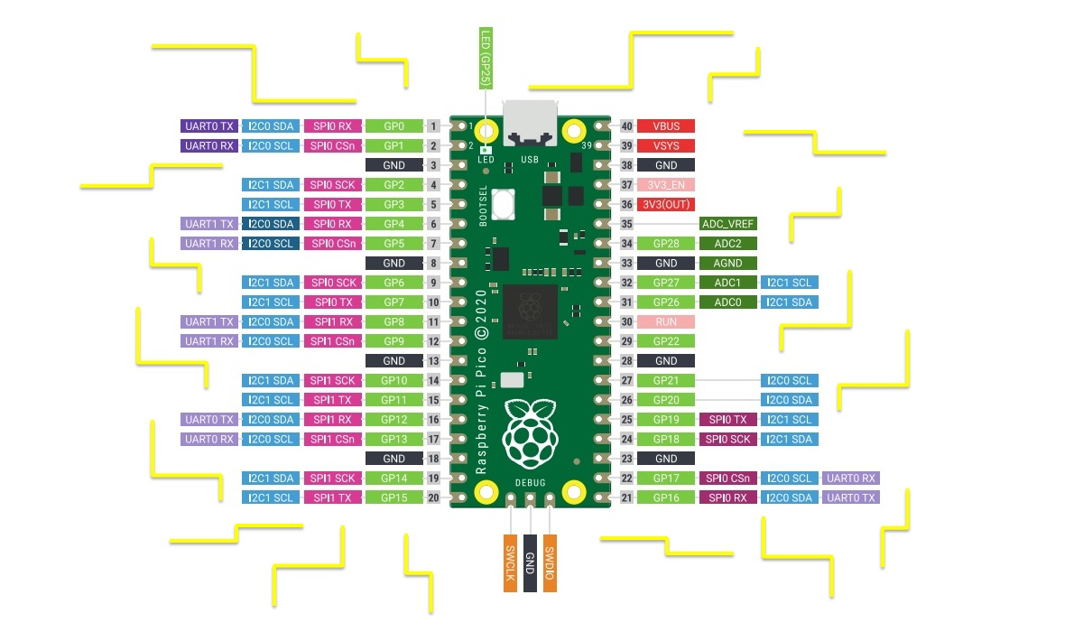
Top View Bottom View
Nov. 2021
AESLAB
7

Slide 8
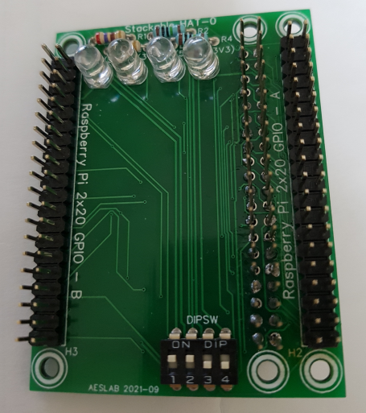
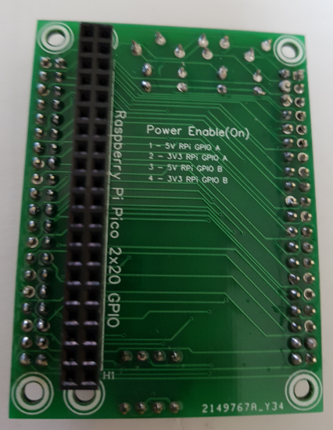
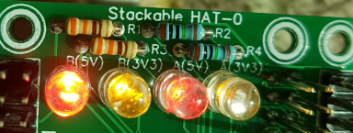
MLS Hat-0 :
MLS Hat-0 for Raspberry Pi 3/4 2x20 GPIO.
2x20 GPIO header for left and right side.
Left and right 5V, 3.3V LEDs, 49x65mm.
Product : MLS Hat-0 PCBA (PCB Assembled)
DIPSW Usage :
1 : GPIO A (Left) 5V Enable & LED A(5V) On
2 : GPIO A (Left) 3V3 Enable & LED A(3V3) On
3 : GPIO B (Right) 5V Enable & LED B(5V) On
4 : GPIO B (Right) 3V3 Enable & LED B(3V3) On
Top Side Bottom Side
Nov. 2021
AESLAB
8

Slide 9
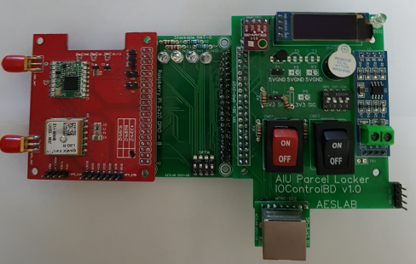
MLS Hat-0 use example
Left side RPi GPIO board RPi means Raspberry Pi.
I2C 0.91” 128x32 OLED
I2C BME280 Temperature and Humidity sensor
LED, Buzzer, TR-Output, Digital Input, DIPSW(x4), Command SW
RS-485 Wire Communication module
SPI RC522 RFID Card Reader with SPI-RJ45 LAN Connector
Right side RPi GPIO board
UART GPS Module
SPI LoRa Wireless Communication module
All these previous RPi GPIO Board functionality works on Pico Base A1
and MLS Hat-0.
RPi 2x20 GPIO Portmap, BCM Type, MicroPython define code is available.
Nov. 2021
AESLAB
9

Slide 10
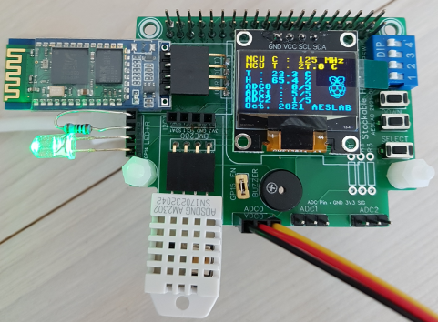
MLS Hat-1 :
MLS Hat-1 for Flowerpot
2x20 GPIO header for left side
LED, Buzzer with 2.54mm jumper for enable and disable
UP/DOWN/SELECT Buttons
DHT22 Temperature & Humidity Sensor
I2C 0.96” 128x64 OLED
ADC for three Capacitive Soil Moisture Sensors
UART HC-06 Bluetooth Wireless module
I2C BM280/AHT10 Temperature & Humidity Sensor (Option)
49x65mm.
Product : MLS Hat-0 PCBA (PCB Assembled)
MLS Hat-0 Set (exclude BME280/AHT10)
DIPSW Usage :
1 : 5V (UART0/BT)
2 : 3V3 (I2C0/DHT22/BTN)
3 : 3V3 (I2C1)
4 : 3V3 (ADC)
More detail information is available in each MLS hat user guide documents.
Nov. 2021
AESLAB
10

Slide 11
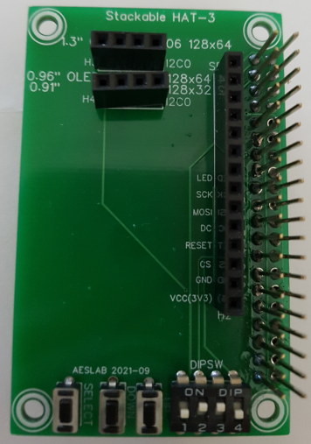
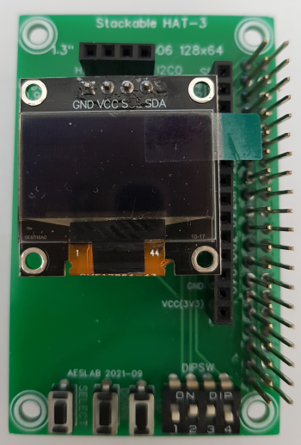
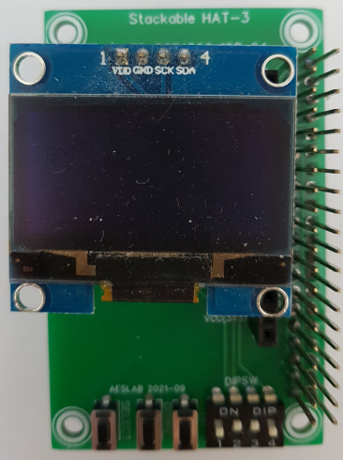
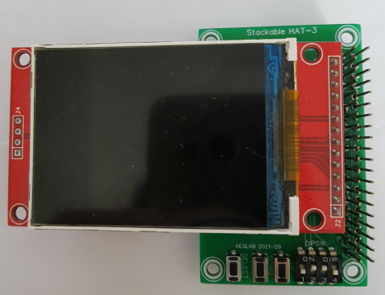
MLS Hat-3 :
MLS Hat-3 for OLED/TFT Display
2x20 GPIO header
SPI 1x14 header, I2C 1x4 header (1.3” and 0.96” OLED
VCC/GND pin position is different)
41x65mm.
Product : MLS Hat-0 PCBA (PCB Assembled)
DIPSW Usage :
1 : None
2 : for SPI 2.2/2.4/2.8” 320x240 ILI9341 TFT module
Also can support 1.44/1.77/1.8” ST7735 TFT
3 : for UP/DOWN/SELECT buttons
4 : for I2C0 I2C SSD1306 1.3” and 0.96” 128x64 OLED
More detail information is available in each MLS hat user guide documents.
Nov. 2021
AESLAB
11

Slide 12
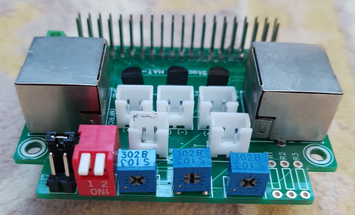
MLS Hat-4 :
MLS Hat-4 for Various IO interfaces
2x20 GPIO header
SPI0, SPI1 with RJ45 LAN Port
Three TR switching output
(Pico internal 5V and external 5~12V KF350-3.5 Connector
with 2.54mm jumper for enable and disable)
two digital 3.3V input
DIPSW(x2) Function select
ADC three potentiometers
49x65mm.
Product : MLS Hat-4 PCBA (PCB Assembled)
SPI-RJ45 : UTP cable up to 10M, STP cable up to double length,
cable length depends on SPI Clock speed. RC522 use 1MHz.
DIPSW Usage :
1 : 5V for TR switching output
2 : 3.3V for SPI0, SPI1
3 : 3.3V for DIPSW(x2), two digital 3.3V input
4 : 3.3V for ADC for three potentiometers
More detail information is available in each MLS hat user guide documents.
Nov. 2021
AESLAB
12

Slide 13
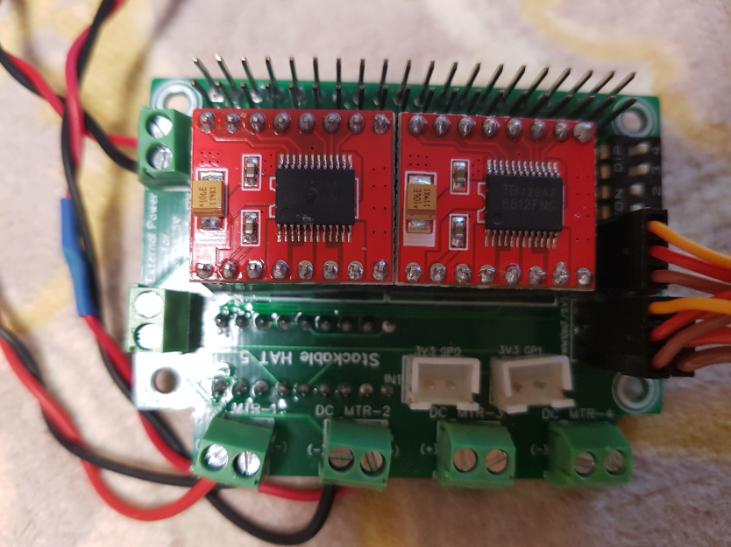
MLS Hat-5 :
MLS Hat-0 for 4 DC Motors, 6 Servo Motors
2x20 GPIO header
External power 12V KF350-3.5 Connector for DC motor
External power 5V KF350-3.5 Connector for Servo motor Two TB6612FNG DC Motor driver (two 1x8) header
49x65mm.
Product : MLS Hat-5 PCBA (PCB Assembled)
MLS Hat-5 Set (2 TB6612FNG DC Motor Driver modules)
TB6612FNG can driver two DC motors.
DIPSW Usage :
1 : 5V Servo PWM1/2 (use Internal 5V)
2 : 3V3 I2C MCP23008 (for TB6612FNG direction control)
3 : 3V3 for TB6612FNG1, 2 module
4 : 3V3 for digital input
More detail information is available in each MLS hat user guide documents.
Nov. 2021
AESLAB
13

Slide 14
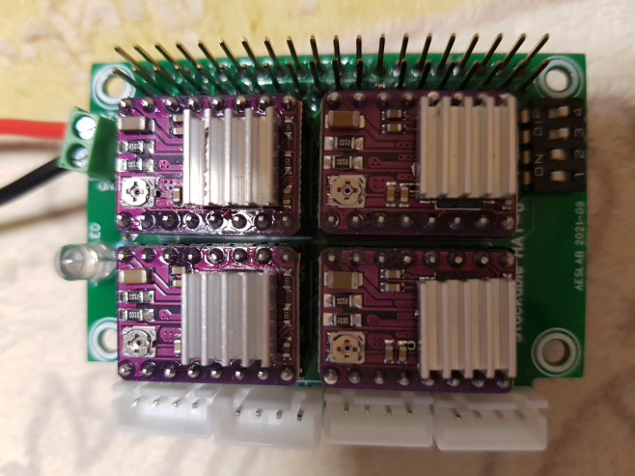
MLS Hat-6 :
MLS Hat-0 for 4 Stepping Motor (NEMA17) drivers.
External power 12V KF350-3.5 Connector
LED, 4 DRV8825 driver (two 1x8) header
49x65mm.
Product : MLS Hat-6 PCBA (PCB Assembled)
MLS Hat-6 Set (DRV8825 Stepping Motor Driver modules)
DIPSW Usage :
1 : 3.3V for 1st DRV8825
2 : 3.3V for 2nd DRV8825
3 : 3.3V for 3rd DRV8825
4 : 3.3V for 4th DRV8825
More detail information is available in each MLS hat user guide documents.
Nov. 2021
AESLAB
14

Slide 15
MLS Hat-X Policy :
First, customer may request dedicated Hat-X that keep MLS Hat form factor and design style development also possible with reasonable cost.
AESLAB always listen to customer’s need carefully and find some possibilities.
Second, also possible custom MLS Hat suggestions. AESLAB will share profit within royalty sharing policy.
Contact : aeslab@naver.com
Thanks!
Nov. 2021
AESLAB
15

